Slide 1


Competition 1
Christmas Card Design

Slide 2
How would you like to have your design on the Trust Christmas card this year?

Slide 3
We are opening our first competition of the year – the Christmas Card design!

Slide 4
It is open to everyone and our winning entries will be printed onto Christmas Cards!

Slide 5

The Rules!

Slide 6

1
The Christmas card design must be inspired by the Christmas season.

Slide 7
2
The design must be suitable to be printed onto an A6 rectangle Christmas card (10.5cm x 15cm)

Slide 8
3
Competitors may use any medium/technique when creating their artwork.

Slide 9
4
Each school is to decide their own winning 2 entries (primaries – one each from KS1/2, secondaries – one each from KS3/4)

Slide 10
5
The closing date for entries to be emailed is 14th November 2025.

Slide 11
6
The artwork entry must have the pupil’s name, school and year group on the submission email.

Slide 12
7
Artwork will be judged by a panel comprising representatives from the Trust. There will be 4 winners (KS1/2/3/4).

Slide 13
8
The Christmas cards printed with the winning designs will credit the artists on the reverse of each card.

Slide 14
9
The cards will be placed on the Trust and individual school websites.

Slide 15
10
As a condition of entry, pupils agree to grant the TrustEd Schools license to reproduce the design (i) on our Christmas cards, (ii) for the promotion of cards sales including online.

Slide 16
Here are last year’s winners!

Slide 17
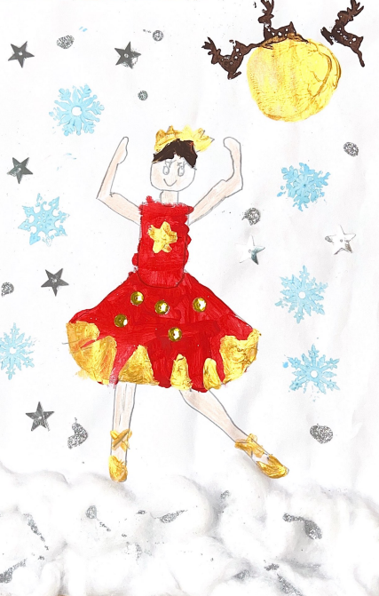
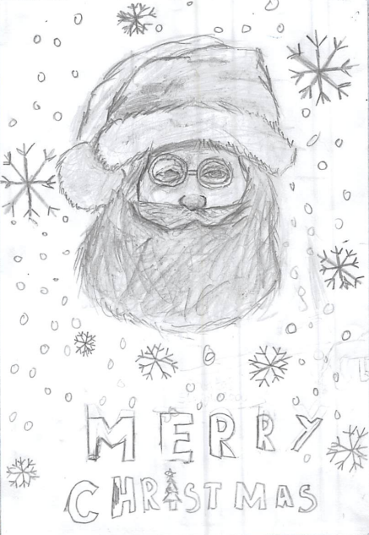
KS1
KS2

Slide 18
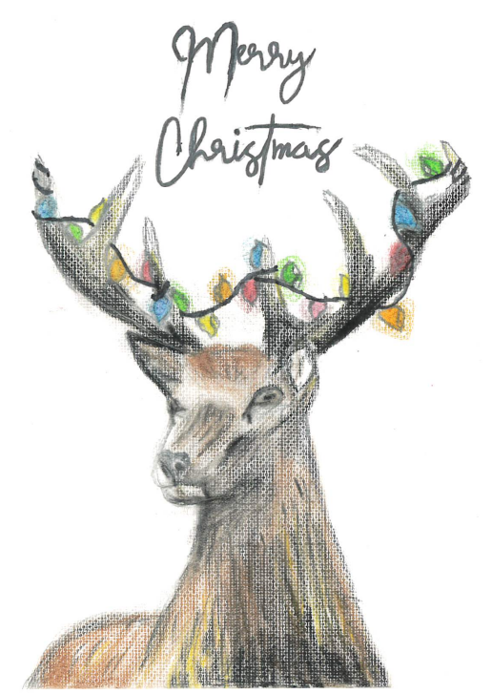
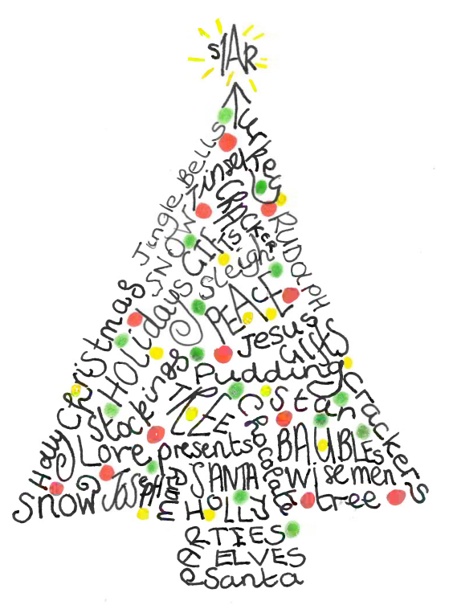
KS3
KS4

Slide 19
We really look forward to seeing what you can produce!!!

