Slide 1


TrustEd Schools
proudly present…

Slide 2
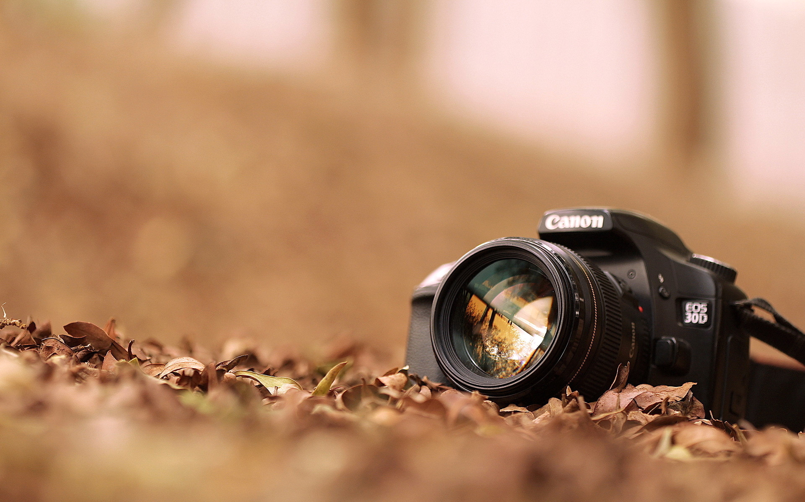
Spring
Photography
competition

Slide 3
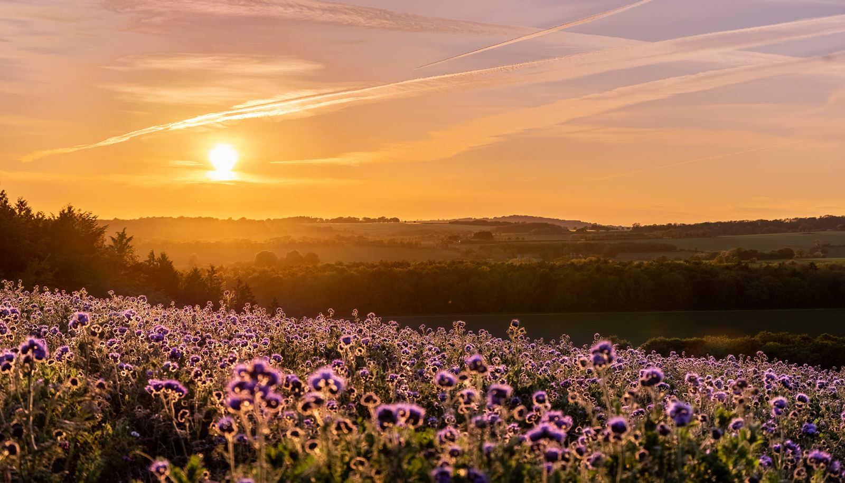
“Step into Spring”
Would your pupils like to capture the energy, colour and joy of the new season?
Enter our Trust photography competition and see their work showcased on our online Trust Gallery!

Slide 4
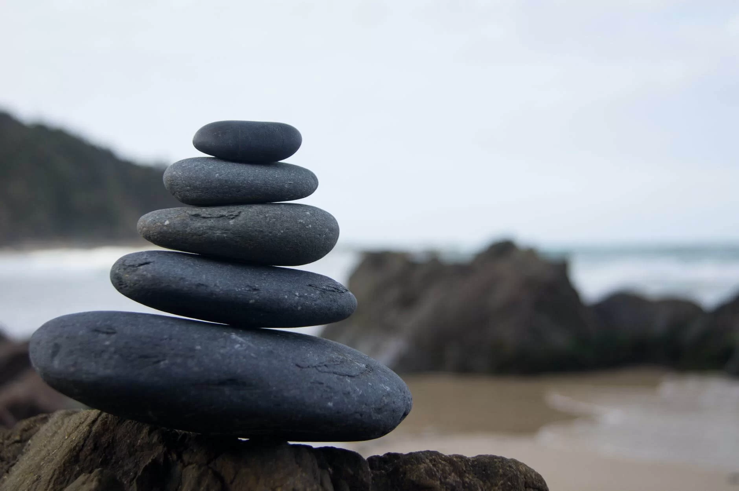
The Rules

Slide 5

1.
The competition is open to all pupils from EYFS to KS4, at all skill levels.

Slide 6
2.
Photos must be original work taken by the pupil themselves.

Slide 7
3.
The Theme is “Step into Spring”
Photos should celebrate the signs, stories or feelings of Spring — nature, growth, light, colour...

Slide 8
4.
Each school can enter up to 10 images from each Key Stage (EYFS, KS1, KS2, KS3 and KS4)

Slide 9
5.
The closing date for entries to be emailed to Mrs Cooper at Castlefields School is Thu5th March

Slide 10
6.
Photo entries will be judged by a panel comprising representatives from the Trust.
There will be 10 overall Champions
(2 each from EYFS/KS1/2/3/4).

Slide 11
7.
As a condition of entry, pupils agree to grant the TrustEd Schools license to reproduce the design on our website.

Slide 12
8.
For more information – see
XXXXXXXXX

