Slide 1


TrustEd Schools
proudly present…

Slide 2
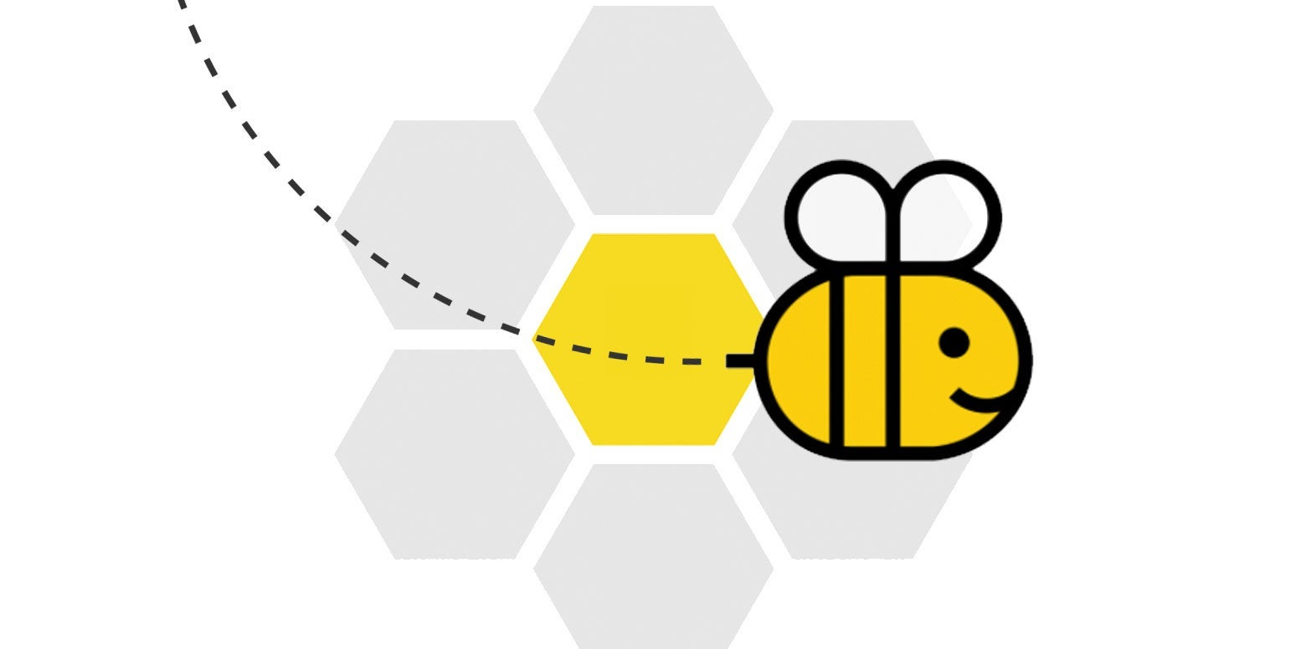
Spelling Bee!!!

Slide 3
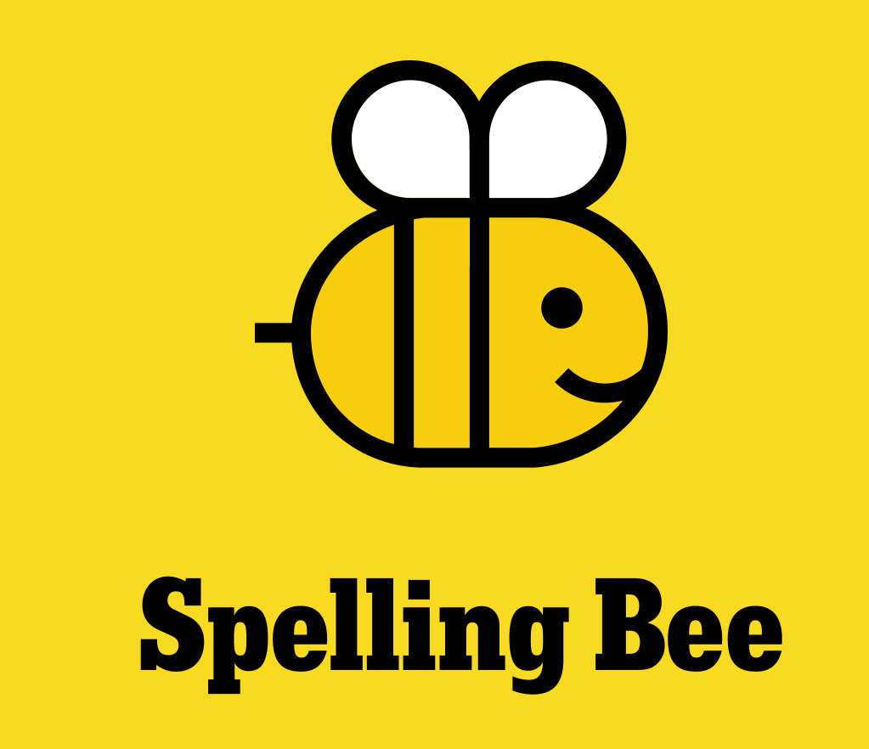
Would your pupils like to showcase their linguistic mastery?!?
Enter our Trust Spelling Bee where young word champions showcase their spelling skills, boost their confidence, and have a blast!
The competition is open to all pupils in KS2 and 3.

Slide 4
The Rules

Slide 5
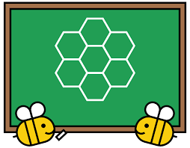
1
The competition is open to all pupils from KS2 + 3

Slide 6
2
Students compete individually
• The competition is broken into rounds. Each contestant gets a turn per round. The level of spelling difficulty increases each round
• Words are chosen from a pre-approved list.

Slide 7
3
• The pronouncer says a word aloud.
• Then, the contestant spells the word out loud.
• After spelling, they must say the word again to indicate they're finished.

Slide 8
4
• Judges check for correct spelling based on the official list.
• KS2: If correct, points for that spelling are awarded to the team total.
• KS3: If correct: the contestant moves to the next round.
• KS3:If incorrect: they are eliminated (though some bees allow for a certain number of misses early on).

Slide 9
6
• KS2: The students continue spelling through 4 rounds of increasingly challenging spellings. At the end of the 4th round, team totals are tallied up to decide on a winning team.
• KS3: The competition continues round by round until only one speller remains.
• KS3: The last speller must spell a final word correctly after the last opponent misspells to officially win.

Slide 10
7
For primary schools, please bring 8 students from KS2 (2 from each of years 3,4,5 and 6)
For secondary schools, please bring 5 students in each year group (15 in total from Y7, 8, 9).

Slide 11
8
For more information – see
XXXXXXXXX

