Slide 1

TrustEd Schools
proudly present…

Slide 2

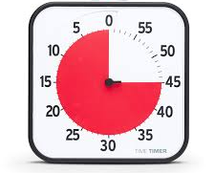

Countdown!

Slide 3
Would your pupils like to showcase their literacy and numeracy skills?!?
Enter our Trust Countdown competition!

Slide 4
Join us for the first Annual TrustEd Champions Countdown Competition, where young champions have fun testing themselves against the clock with words and numbers!

Slide 5
The competition is open to all pupils in Y8 and is hosted at Meole Brace School on Friday 19th June from 9.15-11.15 am

Slide 6
Each school needs to select a team of 4 students for the event.
This can be either through a one-off selection or through an in-school competition to select the best team

Slide 7
All teams compete and score points in each round
The team with the highest number of points at the end wins

Slide 8
